Slide 1

经济学原理：第六讲
蔡洪滨
北京大学光华管理学院
9/26/2011

Slide 2
Ch. 6: Production and Business Organization
Theory of Production and Marginal Product
Business Organization

Slide 3
6A. Theory of Production
What is behind the supply curve?
  behavior of producers----theory of production
Production: the process of transforming inputs (labor, capital and land) into outputs (food, clothing, books, ….)
Inputs----technology---outputs
Recall PPF (production possibility frontier):
  different output combinations that can be produced given technology and inputs.

Slide 4





6A. Production Function
Focus on one particular output: how much can be produced given a certain quantity of inputs?
Production function: the maximum output that can be produced given a certain quantity of inputs.
A particular production function describes a particular technology of transforming inputs into outputs.
For example, , where is the output (e.g., rice) and is labor, and is capital. The function is the production function linking inputs to outputs.

Slide 5

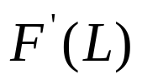

Total, Average, and Marginal Products
Often we want to know how output changes as one input changes. In answering this question, we need to hold other inputs constant.
Total output: , the total amount of output can be produced for a quantity of labor (holding capital fixed).
Marginal output: , the additional amount of output resulting from one additional unit of labor.
Average output: , total output divided by total input

Slide 6
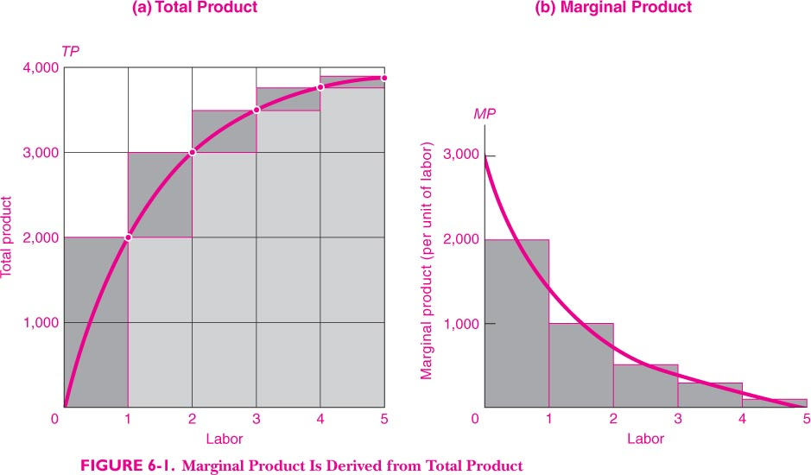

Slide 7
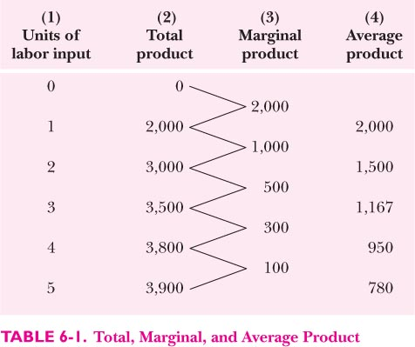

Slide 8
The Law of Diminishing Returns
The law of diminishing returns states that as one input increases (holding other inputs constant), its marginal output decreases.
The key here is that other inputs are held constant.
The law holds as a general principle, not necessarily on every point.
A debate in Chinese economic history: was marginal output of labor in agriculture positive or close to zero or even negative?

Slide 9
Returns to Scale
What if all inputs are increased by the same proportion (e.g., double)?
  Constant returns to scale: a same proportional change in all inputs leads to the same proportional change in output
  Increasing returns to scale (economies of scale): a same proportional change of inputs leads to a more-than-proportional change in outputs.
  Decreasing returns to scale (diseconomies of scale): a same proportional change of inputs leads to a less-than-proportional change in outputs.

Slide 10
Returns to Scale
Returns to scale can vary as the input level changes or technology changes.
In the case of increasing returns to scale, firms will want to expand their operation scales to save costs and produce more efficiently, or two similar firms should merge into one.
In industries with strong economies of scale, we tend to see large firms.

Slide 11
Short Run and Long Run
Change production level takes time.
Variable factors (e.g., labor, materials) are those inputs that can be changed in the short run.
Fixed factors (e.g., large machinery, plants) are those inputs that can only be changed in the long run.

Slide 12
Technological Change
Large Technological Changes:
  Three industrial revolutions.
  Debate: continuous or jumps?
  Debate: cause or effect of economic growth
Process or product innovation
Technologic Advances: more outputs can be produced from the same amount of inputs. That is, technological advances increase productivity.

Slide 13
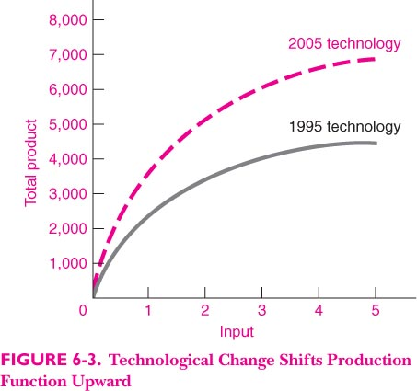

Slide 14
Network Effect
Communication networks (e.g., phone, email):
  the value to a consumer depends on how many others are on the network, i.e., adoption externality.
This implies increasing returns to scale, thus large “systems” tend to emerge: Microsoft operating system, Apple, ..
Once a system is formed, it is hard to change, so it can exhibit inertia for quite a while.

Slide 15
Productivity
Productivity: ratio of output to inputs
Labor productivity: amount of output per unit of labor
Total factor productivity: output per unit of an input index.
Productivity growth:
  technological advance
  economics of scale :
  economics of scope:
  institutional improvement

Slide 16
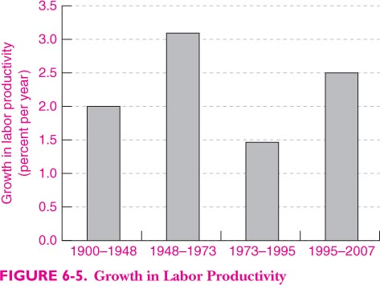

Slide 17
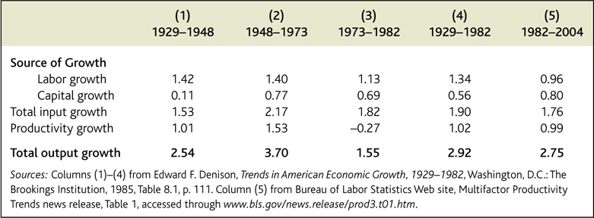
二、影响长期经济增长的因素和原因
美国经济增长因素分解

Slide 18
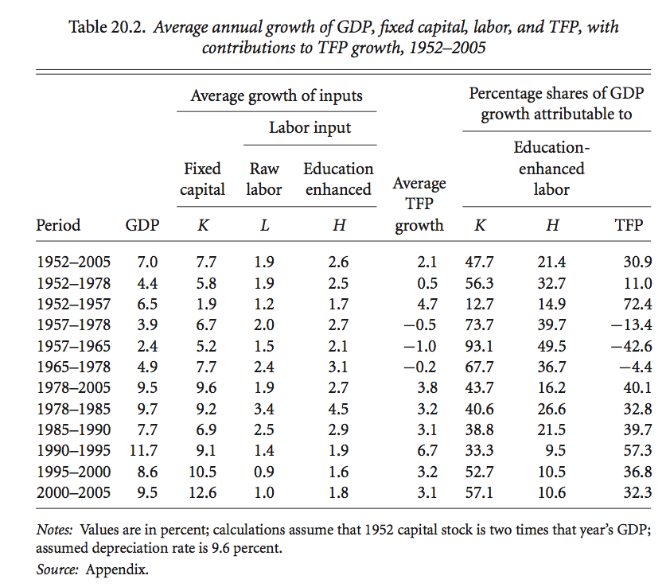
二、影响长期经济增长的因素和原因
中国经济增长因素分解

Slide 19
B. Business Organizations
Business firms: organization of production process.
Firms: three functions (as compared with household self-reliance)
  Specialization
  Coordination
  Raising capital and resources
Firms versus Market (Coase 1937): what determines the boundary of the firm?
  transaction cost theory
  Property right theory of the firm
  ……

Slide 20
Legal types of firms
Individual Proprietorship: usually very small in size
Partnerships: unlimited liability or limited liability
Corporation:
  A legal person with limited liability.
  Ownership of stocks
  Separation of ownership and management

Slide 21
Ownership, Control, and Executive Compensation
Public corporations:
  Listed on stock exchanges
  Diverse ownership
  No large shareholders
Separation of ownership and Control
  Management has effective control
  Management and board of directors
Who hires and monitor and fires CEO?
  Recently HP

Slide 22
Ownership, Control, and Executive Compensation
How is executive compensation determined?
  Some argue it is determined to provide proper incentives so that CEOs maximize company value.
  Others argue it is determined by CEOs themselves.
Family Firms and Professional Firms:
  Family firms: controlled by founding family
  Control is inheritable: the pool of talents
  Crowding out talents: family versus professional manager
  Corporation in Chinese history: 晋商与徽商

Slide 23
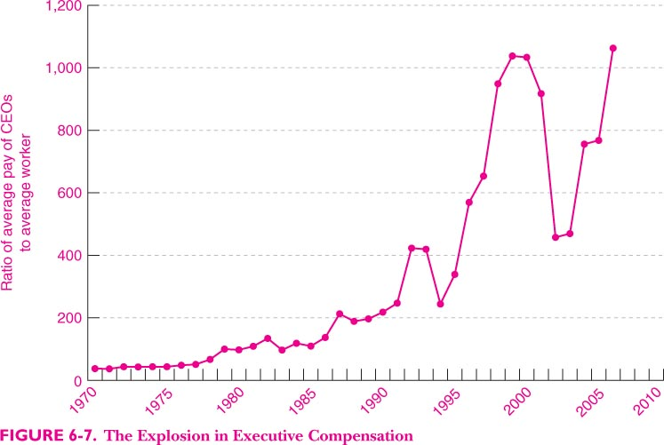

Slide 24
Private and State-owned Enterprises
State-owned enterprises: central-planning’ foundation
Problems with SOEs:
  Who are the “people” owners? Property rights are unclear
  Managers’ incentives are not aligned with state owners.
  Inefficiency
  Monopoly
  Corruption
SOEs Reforms：
  From contracting to modern corporations
  Privatization

Slide 25
Reminder:
  Review Chapter 6
  Preview Chapter 7
  Homework 2 due on October 12 in class.
  Thank you!

